Slide 1
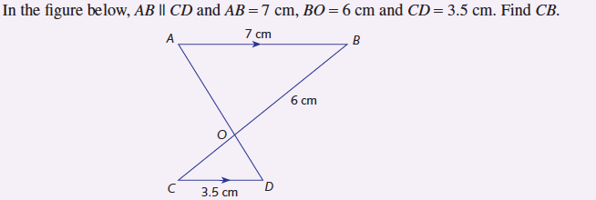

Find the length of BC.
E
12 cm
B
5 cm
3 cm
A
2 cm
C
8 cm
D

Slide 2
Example 5
E
Find the length of BC.
12 cm
B
5 cm
3 cm
A
2 cm
C
8 cm
D

Slide 3
Using equations to solve problems - 2
Solving Word Problems

Slide 7
